Slide 1
Software Testing Fundamentals

Slide 2
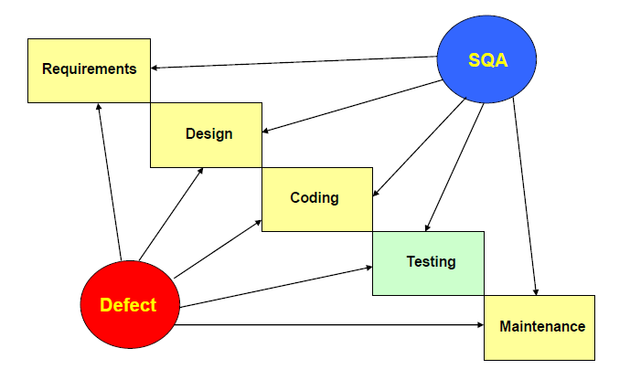
Review & Inspections

Slide 3
Software Testing
Software testing is a process used to identify the correctness, completeness and quality of developed computer software.
It is the process of executing a program / application under positive and negative conditions by manual or automated means. It checks for the :-
Specification
Functionality
Performance

Slide 4
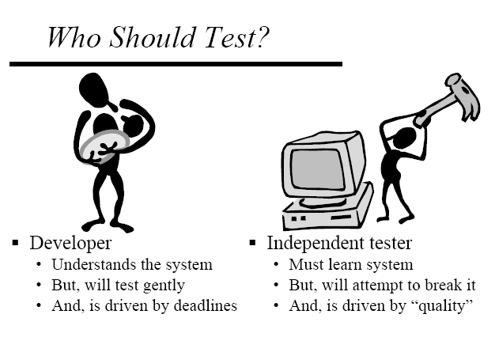

Slide 5

Objectives of testing
Direct objectives
■ To identify and reveal as many errors as possible in the tested software.
■ To bring the tested software, after correction of the identified errors and retesting, to an acceptable level of quality.
■ To perform the required tests efficiently and effectively, within budgetary and scheduling limitations.
2. Indirect objective
■ To compile a record of software errors for use in error prevention (by corrective and preventive actions)
Notes:
(C) 2015, Quality Partners™

Slide 6
The Testing Team
Program Manager-
The planning and execution of the project
Responsible for managing the schedule and making the critical decisions and trade-offs.
QA Lead-
Coach and mentor other team members
Implement industry best practices related to testing automation and
To streamline the QA Department.

Slide 7
Test Analyst\Lead-
Responsible for planning, developing and executing automated test
systems, manual test plans and regressions test plans.
Gathering and managing the Test Data
Evaluating the outcome of each test cycle
Test Engineer-
Writing and executing test cases and Reporting defects

Slide 8
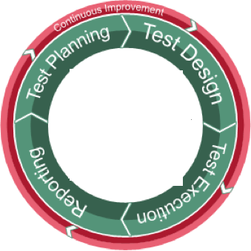
Software Testing Lifecycle (STLC)
Notes:
(C) 2015, Quality Partners™

Slide 9
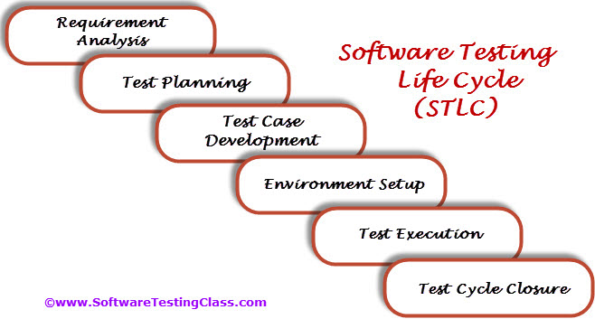

Slide 10
Test Planning
Test effort estimation and resource planning.
Selection of testing tool if required.
Define the test environment required for entire project.
Prepare the test schedules.
Determining roles and responsibilities.
List down the testing deliverable.
Entry Criteria | Deliverable
Requirements Documents Automation feasibility report | Test Plan or Test strategy document.

Slide 11
Test Case Development
Preparation of test cases.
Preparation of test automation scripts (if required).
Pre-requisite test data preparation for executing test cases.
Entry Criteria | Deliverable
Requirements Documents Automation feasibility report. | Test cases. Test data. Test Automation Scripts

Slide 12
Test Planning

Slide 13
Test Plan
A test plan is a systematic approach to testing a system i.e. software. The plan typically contains a detailed understanding of what the eventual testing workflow will be.

Slide 14
Test Case
A test case is a specific procedure of testing a particular requirement.
It will include:
Identification of specific requirement tested
Test case success/failure criteria
Specific steps to execute test
Test Data

Slide 15

What are the characteristics of a good Test Case?
Testability; easy to be executed
Use active case, do this, do that, system displays this, does that
Simple, conversational language
Exact, consistent names of fields, not generic
10-15 steps or less. In the case of integration test case’s try to provide references instead of explaining the functionality again and again
Test cases are always updated along with new build
Notes:
(C) 2015, Quality Partners™

Slide 16
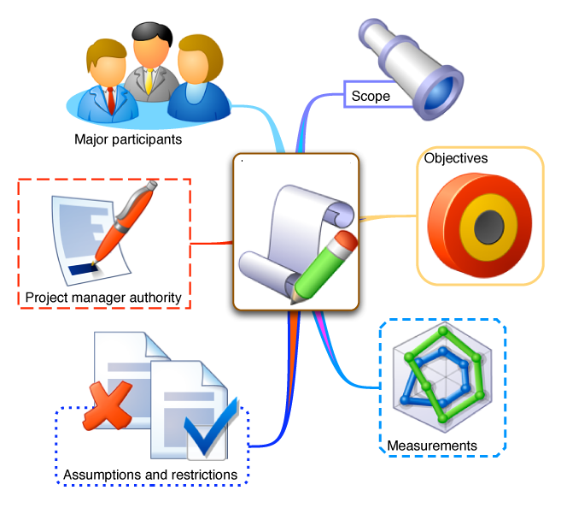
What are the main components of the good Test Plan?
Introduction
  1.1 Objectives
  1.2 Scope (In scope and out of scope)
  1.3 Roles & Responsibilities
  1.4 Risks and Dependencies
  1.5 Deliverables
2. Resources and Environment Requirements
  2.1 Staffing and Training needs
  2.2 Test Environment
  2.3 Test Tools Requirements
  2.4 Test Data
Notes:
(C) 2015, Quality Partners™

Slide 17

What are the main components of the good test plan (cont’d)?
3. Schedule
4. Test Monitoring and Reporting
5. Pass/Fail criteria
Notes:
(C) 2015, Quality Partners™

